Slide 1
RELATIONAL DATABASE ARCHITECTURE
Design & Implementation of a DBMS for Microfinance Loan & Repayment Management
Normalized 3NF relational schema, transactional integrity constraints, automated trigger logic, and SQL analytics for financial risk management.
FOCUS AREA
INTEGRITY GUARANTEE
ANALYTICS ENGINE
3NF Schema & SQL Engine
ACID Compliance & Triggers
PAR Risk & Portfolio Tracking

Slide 2
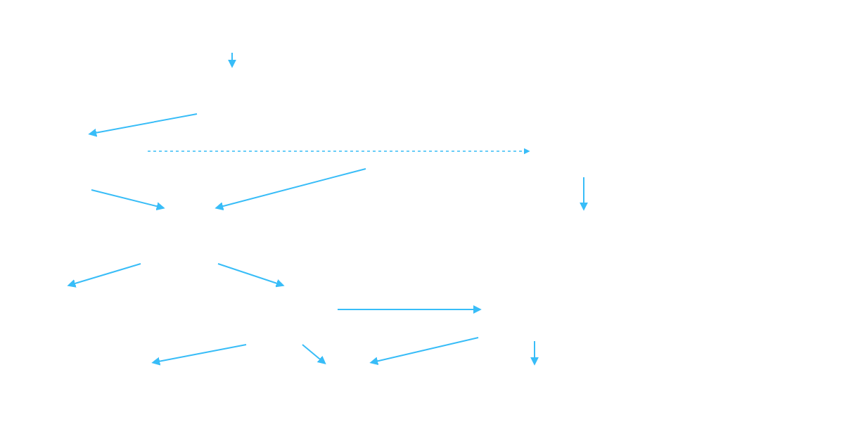
Relational Schema Architecture
Complete Microfinance ER Diagram Flowchart
PK = Primary Key
FK = Foreign Key
1:1 / 1:N Flow Relationships
FIELD_OFFICERS
int officer_id PK
string full_name
string phone
string assigned_zone
manages (1:N)
GROUPS
int group_id PK
int officer_id FK
string group_name
contains (1:N)
string meeting_day
CLIENTS
LOAN_PRODUCTS
SAVINGS_ACCOUNTS
int client_id PK
holds (1:1)
int product_id PK
int account_id PK
int group_id FK
string product_name
int client_id FK
string national_id
decimal interest_rate
decimal current_balance
string full_name
governs (1:N)
int duration_months
date opened_date
string kyc_status
logs (1:N)
submits (1:N)
APPLICATIONS
TRANSACTIONS
int application_id PK
int transaction_id PK
int client_id FK
int account_id FK
int product_id FK
string transaction_type
decimal requested_amount
decimal amount
evaluated_by (1:1)
string status
date transaction_date
converts_to (1:1)
APPROVALS
LOANS
SCHEDULES
int approval_id PK
int loan_id PK
generates (1:N)
int schedule_id PK
int application_id FK
int application_id FK
int loan_id FK
int officer_id FK
decimal principal_amount
date due_date
string decision
decimal interest_rate
decimal principal_due
date approval_date
disbursed_via (1:1)
string status
satisfied_by (1:N)
decimal interest_due
receives (1:N)
triggers_if_overdue (1:N)
string status
DISBURSEMENTS
REPAYMENTS
PENALTIES
int disbursement_id PK
int repayment_id PK
int penalty_id PK
int loan_id FK
int loan_id FK
int loan_id FK
decimal disbursed_amount
int schedule_id FK
int schedule_id FK
date disbursement_date
decimal amount_paid
decimal penalty_amount
string payment_method
date payment_date
boolean is_paid

Slide 3
Schema Rigor
Functional Dependencies & 3NF Normalization
1NF Compliance
2NF Decomposition
3NF Verification
Atomic attribute values.
Zero partial dependencies.
Zero transitive dependencies.
Eliminated repeating payment schedules into standalone schedule records.
Separated Client personal attributes from Loan and Group associations.
Extracted Loan Product caps ($FD: Product \rightarrow MaxAmount$) into LOAN_PRODUCT.
Key Functional Dependencies (FDs):
FD1: loan_id → client_id, product_id, principal, status, approval_date
FD2: product_id → min_principal, max_principal, interest_rate, max_tenure
FD3: (loan_id, installment_no) → due_date, principal_due, interest_due

Slide 4
Data Dictionary
Core Relational Specifications
Table | Attribute | Data Type | Keys / Constraints | Business Meaning
LOAN_PRODUCT | max_amount | DECIMAL(12,2) | NOT NULL, CHECK > 0 | Upper limit allowed per borrowing product
LOAN_ACCOUNT | approved_amount | DECIMAL(12,2) | CHECK ≤ product.max_amount | Sanctioned principal amount
LOAN_ACCOUNT | disbursed_date | DATE | CHECK ≥ approval_date | Date cash was disbursed to client
SAVINGS_ACC | balance | DECIMAL(12,2) | CHECK ≥ 0.2 * loan.amount | 20% mandatory collateral deposit
REPAYMENT | amount_paid | DECIMAL(12,2) | CHECK ≤ outstanding_bal | Prevents overpayment transaction excess

Slide 5
Database Implementation
DDL Scripts & Business Integrity Rules
CREATE TABLE loan_product ( product_id INT PRIMARY KEY, product_name VARCHAR(50) NOT NULL, max_limit DECIMAL(12,2) NOT NULL CHECK (max_limit > 0) ); CREATE TABLE loan_account ( loan_id INT PRIMARY KEY, client_id INT REFERENCES client(client_id), product_id INT REFERENCES loan_product(product_id), approved_amount DECIMAL(12,2) NOT NULL, approval_date DATE NOT NULL, disbursement_date DATE, outstanding_balance DECIMAL(12,2) NOT NULL, status VARCHAR(20) CHECK (status IN ('APPLIED', 'APPROVED', 'DISBURSED', 'CLOSED')), CONSTRAINT chk_approval_before_disburse CHECK (disbursement_date >= approval_date) );

Slide 6
Procedural Integrity
Triggers: Savings & Product Limits Control
-- Trigger enforcement: Approved amount within Product Limit & Cash Collateral check CREATE OR REPLACE FUNCTION verify_loan_disbursement() RETURNS TRIGGER AS $$ DECLARE v_max_limit DECIMAL(12,2); v_savings_bal DECIMAL(12,2); BEGIN SELECT max_limit INTO v_max_limit FROM loan_product WHERE product_id = NEW.product_id; IF NEW.approved_amount > v_max_limit THEN RAISE EXCEPTION 'Approved amount exceeds product maximum cap'; END IF; SELECT current_balance INTO v_savings_bal FROM savings_account WHERE client_id = NEW.client_id; IF v_savings_bal < (NEW.approved_amount * 0.20) THEN RAISE EXCEPTION 'Client lacks required 20%% mandatory savings collateral'; END IF; RETURN NEW; END; $$ LANGUAGE plpgsql;

Slide 7
Risk Analytics
SQL View: Overdue Loans & PAR Calculation
CREATE VIEW vw_overdue_portfolio AS SELECT l.loan_id, c.full_name AS client_name, s.due_date, (s.principal_due + s.interest_due - s.amount_paid) AS overdue_amount, CURRENT_DATE - s.due_date AS days_in_arrears, CASE WHEN CURRENT_DATE - s.due_date > 90 THEN 'PAR 90 (NPL)' WHEN CURRENT_DATE - s.due_date > 30 THEN 'PAR 30 (Watchlist)' ELSE 'PAR 1-30 (Substandard)' END AS risk_category FROM repayment_schedule s JOIN loan_account l ON s.loan_id = l.loan_id JOIN client c ON l.client_id = c.client_id WHERE s.due_date < CURRENT_DATE AND s.status != 'PAID';

Slide 8
Repayment Execution
Repayment Processing & Balance Subquery
-- Payment posting trigger enforcing repayment within balance CREATE OR REPLACE FUNCTION process_repayment() RETURNS TRIGGER AS $$ DECLARE v_outstanding DECIMAL(12,2); BEGIN SELECT outstanding_balance INTO v_outstanding FROM loan_account WHERE loan_id = NEW.loan_id; IF NEW.amount_paid > v_outstanding THEN RAISE EXCEPTION 'Repayment amount exceeds remaining loan balance'; END IF; -- Deduct paid amount from loan balance UPDATE loan_account SET outstanding_balance = outstanding_balance - NEW.amount_paid WHERE loan_id = NEW.loan_id; RETURN NEW; END; $$ LANGUAGE plpgsql;

Slide 9
Portfolio Reporting
Group Performance & Officer Metrics
-- Aggregation Query: Officer Portfolio Health & Group Risk Analysis SELECT o.officer_id, o.officer_name, COUNT(DISTINCT g.group_id) AS active_groups, COUNT(l.loan_id) AS total_loans_issued, SUM(l.approved_amount) AS gross_portfolio, ROUND(AVG(c.credit_score), 2) AS avg_borrower_credit FROM loan_officer o JOIN borrower_group g ON o.officer_id = g.officer_id JOIN client c ON g.group_id = c.group_id JOIN loan_account l ON c.client_id = l.client_id GROUP BY o.officer_id, o.officer_name HAVING COUNT(l.loan_id) > 5;

Slide 10


Financial Safeguards
Savings Balance Control & Penalties
20% Savings Lock Rule
Automated 2% Penalty
ACID Compliance
Guarantees cash collateral reserve. Client cannot withdraw below threshold while loan is active.
Daily batch calculation adds 2% penalty on overdue installment amounts past 5-day grace period.
Atomic repayment distribution prevents partial state anomalies across schedule and ledger.

Slide 11
Implementation Prototype
Database Execution Output Log
-- TEST 1: Attempt loan disburse exceeding product limit SQL> INSERT INTO loan_account VALUES (101, 5, 1, 15000.00, '2026-03-01', '2026-03-02', 15000.00, 'APPROVED'); ERROR: Approved amount exceeds product maximum cap ($10,000.00) -- TEST 2: Attempt repayment exceeding outstanding balance SQL> INSERT INTO repayment_transaction VALUES (901, 101, '2026-03-15', 20000.00); ERROR: Repayment amount exceeds remaining loan balance ($9,500.00) -- TEST 3: Valid repayment execution SQL> INSERT INTO repayment_transaction VALUES (902, 101, '2026-03-15', 2500.00); SUCCESS: 1 row inserted. Loan 101 balance updated to $7,000.00.

Slide 12
System Implementation Verified & Complete
Robust & Scalable Microfinance DBMS
Enforces zero-data-anomaly standard up to 3NF with trigger-based financial constraints and automated risk tracking.

